Slide 1
Intercultural Communication
Week 5: Immigration and acculturation
Dr Stella Bullo

Slide 2
Immigration and Acculturation
National boundaries do not necessarily overlap cultural boundaries
At times, boundaries sometimes result in a blended culture
At other times, national boundaries denote distinctive cultural differences and tensions
Within national cultures, co-cultures can exist in voluntary or fixed separation

Slide 3
Immigration is a test ICC skills
Non-immigrants
Tourists & sojourners
Immigrants
Refugees & asylees
Expatriates (a noncitizen worker who lives in a country for an indeterminate length of time)

Slide 4
Third culture
Third-culture kids to refer to children in expatriate families who reside outside of their home culture for years at a time (Hill Useem,1976)
These people integrate elements of their home culture and their various cultures of residence into a third, different and distinct culture.

Slide 5
Third culture II
They may experience cultural marginality because of no longer feeling comfortable in any specific culture.
Studies have shown that third-culture kids have a high level of interest in travel and learning languages and feel accepting of cultures and diversity.

Slide 6
Citizenship acquisition
by birth
by blood
by naturalization

Slide 7
Worldwide migration
The number of people counted as living outside their country of birth has almost doubled during the last 50 years
Brazil is home to the largest Japanese community outside Japan.
The Japanese in Peru have gone through periods of prejudice to assimilation as an immigrant’s son became a popular president of the country.
Tens of thousands of middle-class Koreans from South Korea and North Korea moved to Brazil.

Slide 8
Worldwide migration II
Argentina, with a population of about 42 million, is a nation of immigrants.
By 1914, more than a third of Argentina’s population was foreign born.
Argentina has been described as the “most European” of the Americas.

Slide 9
Worldwide migration III
Western Europe deals with increasing immigration, particularly from Muslim countries.
The Islamic population in Europe has doubled over the past decade to as much as 15 million.
European countries have adopted various policies to the growing Muslim immigration.

Slide 10
Migration within countries: China
Most of the migrants originate from the central and western inland regions and move to the cities in the eastern coastal provinces.
Each year millions return to their villages to see their spouses, children, and parents for two weeks of holiday at Chinese New Year.
China needs these migrants for economic growth, but they are not accorded the rights of urban residents.

Slide 11
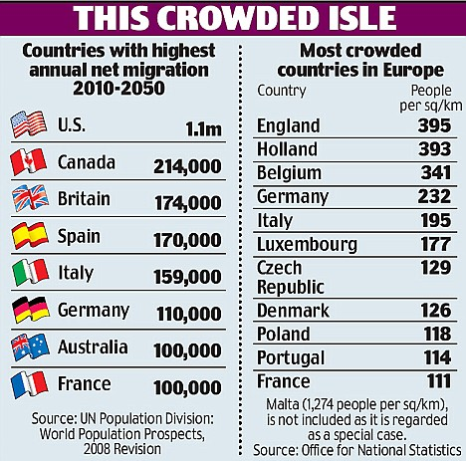

Slide 12
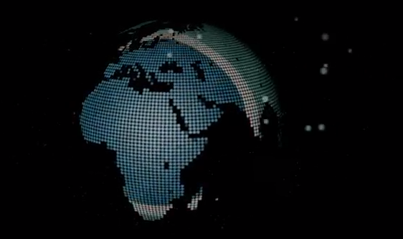
International migration
Notes:
http://www.youtube.com/watch?v=lOZmqIwqur4&feature=related

Slide 13
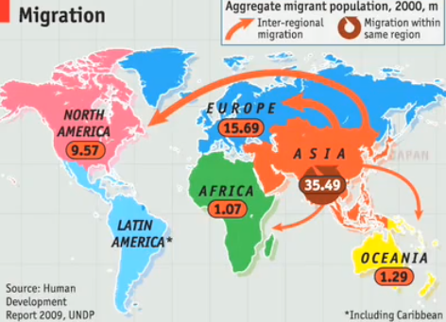
Worldwide migration
Notes:
http://www.youtube.com/watch?v=hcoOENLfpUI&feature=related

Slide 14
Migration in the UK (1922 British Nationality Law)
From the Republic of Ireland and from the former colonies and territories of the British Empire
India, Bangladesh, Pakistan, the Caribbean, South Africa, Kenya and Hong Kong.
Others have come as asylum seekers, seeking protection as refugees under the United Nations 1951 Refugee Convention
Member states of the European Union, exercising one of the European Union's Four Freedoms.

Slide 15
Migration in the UK
in 2009, 567,000 people arrived to live in the UK
371,000 left
net inward migration:196,000 (in 2009).

Slide 16
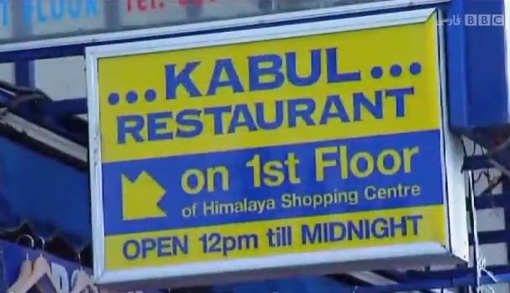
Multiculturalism in the UK
Notes:
http://www.youtube.com/watch?v=yuqXO-ENu5Y

Slide 17
Culture shock
Intercultural barrier identified as anxiety
Feelings of disorientation and anxiety experienced for a period of time while living in a foreign country (Oberg,1960)
Results from awareness that assumptions about life and ways of behaving are no longer appropriate or functional
Psychological and physiological effects

Slide 18
Culture shock: testimonials
“…soon after arriving in the US from Peru, I cried almost every day. I was so tense…I escaped into sleeping more than twelve hours a day and dreamed of my life, family and friends in Lima. After three months of isolating myself in the house and speaking to no one, I ventured out. I then began to criticise everything about this new culture: values, customs, climate, and its people. During this time I began to idealise my own homeland. I also began to have severe headaches. Finally I consulted a doctors who was not able to help by only prescribing drugs. When I finally learnt that I was suffering from ‘culture shock’ I began to see things from a new point of view and was better able to accept myself and my feelings…” (R. Bimrose in Landis & Brislin, 1983, p. 30).

Slide 19
Five stages of culture shock (Adler & Pedersen, 1975; 1995)
Honeymoon stage or euphoria
Disintegration of familiar cues and irritation with differences
Reintegration of new cues & ability to function in new culture
Gradual adjustment; gradual autonomy; seeing good and bad elements in new culture
Reciprocal interdependence or biculturalism

Slide 20
reverse culture shock
If a person has adjusted exceptionally well to the host culture, reverse culture shock may occur upon return to the home country

Slide 21
Acculturation
No immigrant can escape acculturation
Immigrant’s learning and adopting the norms and values of the new host culture
Balance between
the value placed on maintaining one’s original cultural identity
the value given to maintaining relationships in one’s new culture (Berry, Kim, and Boski, 1987)

Slide 22
Predictors of acculturation (Yun Kim,1986)
The similarity of the original culture to the new host culture
Age
Educational background
Personality
The effect of media and transportation advances has slowed acculturation process---social media made it easier to connect to like cultures, home

Slide 23
Processes in Acculturation
Marginalization: losing one’s cultural identity and not having any psychological contact with the larger society.
Separation and segregation: maintaining one’s original culture and not participating in the new culture.
Assimilation results from giving up one’s original cultural identity and moving into full participation in the new culture.
Integration is maintaining important parts of one’s original culture as well as becoming an integral part of the new culture – biculturalism

Slide 24
Attitudes to immigration in Britain
Attitudes towards immigration and immigrants themselves are largely negative
Immigration and race relations are consistently regarded as one of the most important issues facing Britain
in 2011 ¾ of people viewed immigration as a “big problem”

Slide 25
Attitudes to immigration II
The main reasons people view immigration in a negative manner is the perceived burden on public services, and pressure on jobs and employment
As the economic downturn has evolved these attitudes have been exacerbated
Negative attitudes increase with age and attitudes among the older generations have remained relatively stable

Slide 26
Attitudes to immigration III: the media
Many attitudes on immigration are formed on misconceptions.
In 2011 for example almost 60% of people incorrectly thought that Britain had a higher proportion of both immigrants and asylum seekers than other countries in Europe.
These misconceptions and general attitudes are borne out of (often hostile) media exposure rather than personal experience
69% of people listed TV as a main source of information on immigration and asylum, 44% said newspapers and only 16% said personal experience
Source: http://www.3s4.org.uk/drivers/attitudes-towards-immigrants

Slide 27
To think….
The local’s perspective
The immigrant’s side (culture shock, acculturation)
The role of the media in promoting attitudes towards immigration
Barriers to ICC from both sides

